Slide 1

CUSTOMER CARE REGISTRY
LITERATURE SURVEY

Slide 2

TEAM DETAILS:
Team No College Name Department
: PNT2022TMID10732
: IFETCOLLEGE OFENGINEERING
: ECE

Slide 3
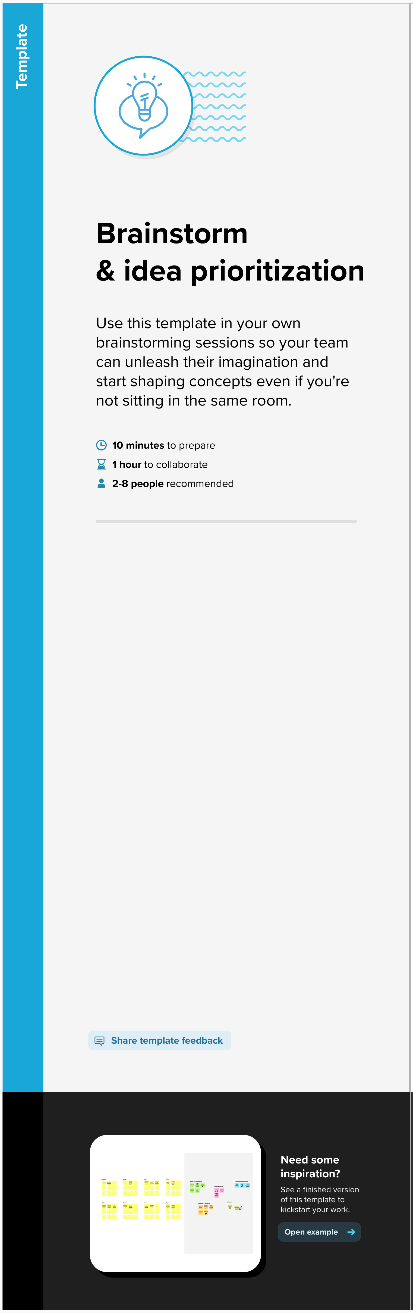

Slide 4


Slide 5


Slide 6
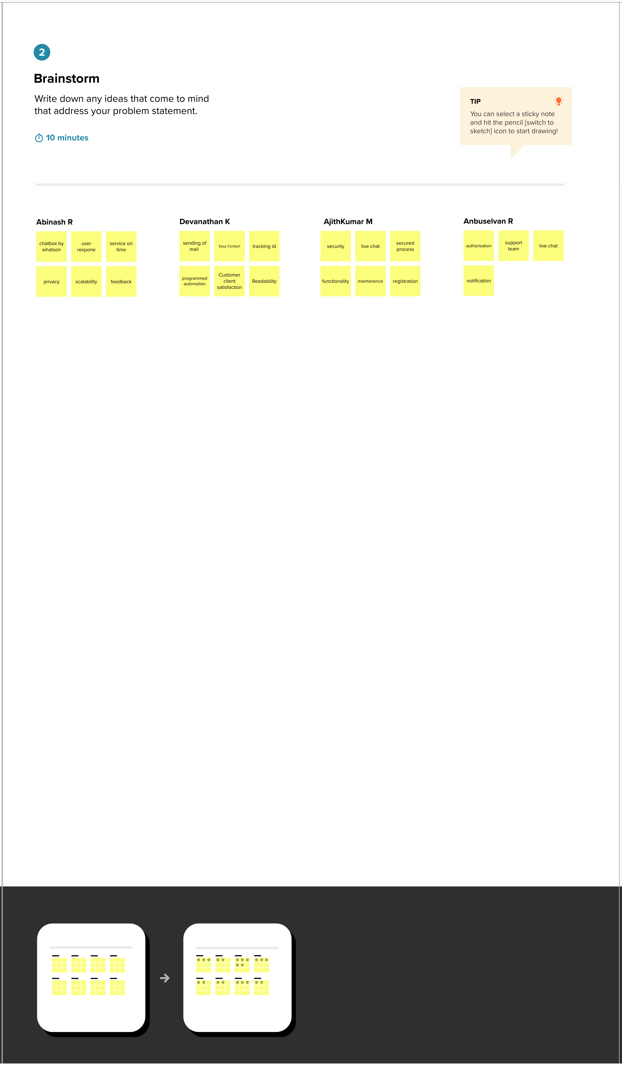

Slide 7
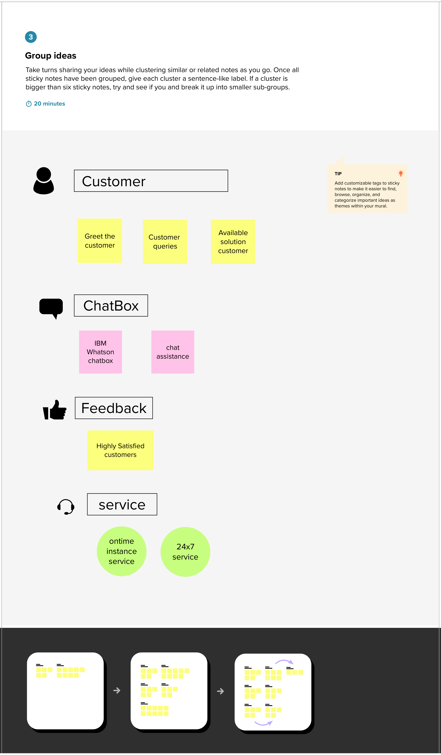

Slide 8
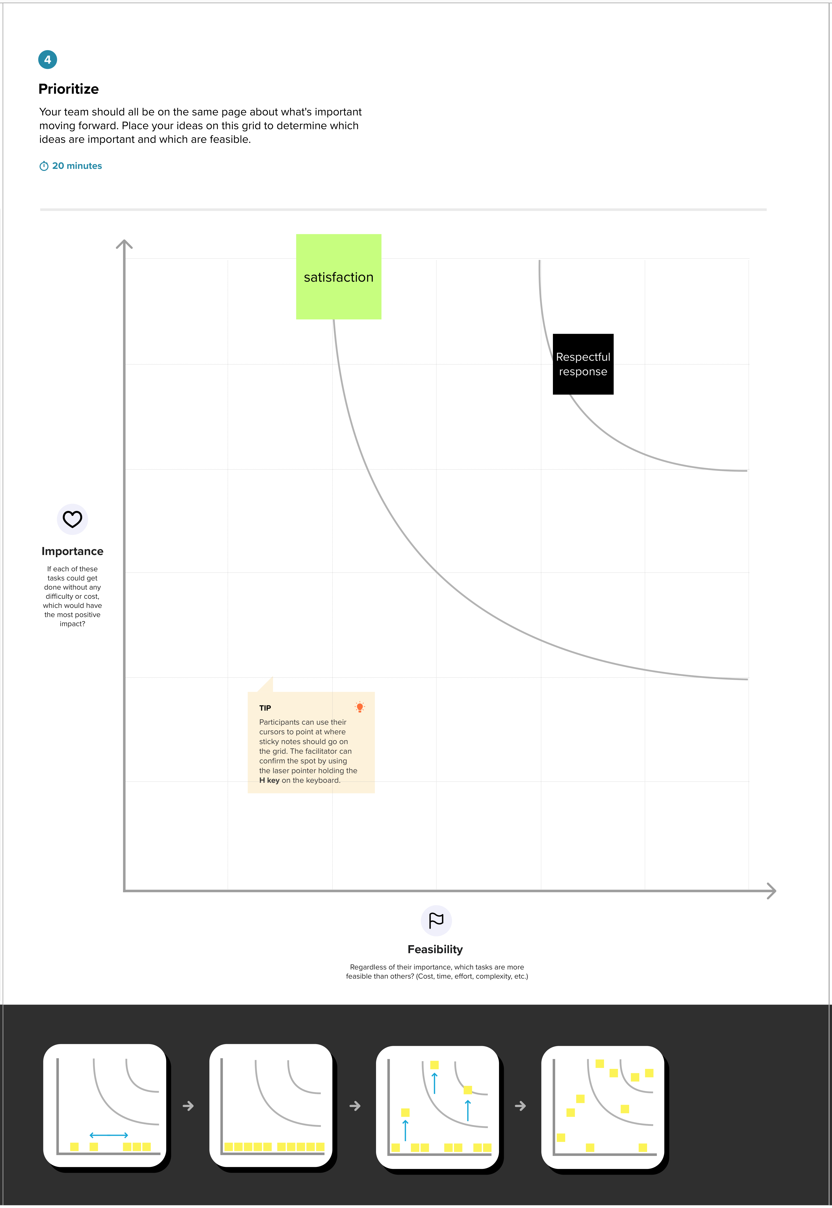

Slide 9


Slide 10
Thank you

